Slide 1
S-57 to S-101 Conversion Subgroup Meeting

Slide 2
Subgroup Meeting Progress and Agenda
Update on progress sent out with meeting invite.
Agreement to focus on using the re-modelling spreadsheet as the initial driver for the group’s outputs.
Also, focus on edge cases, not the simple dictionary transformations.
Agenda for meeting
Re-modelling Spreadsheet (JP)
S-58 approach, how we can take that forward (TR)
Edge cases, introduce and categorise (JP)
Overall documentation approach (e.g. DCEG vs feature catalogue etc...) (All)
Splitting up the effort (All)
Tools and Technologies (CM)
Participation, Data, use of Github etc... AOB

Slide 3
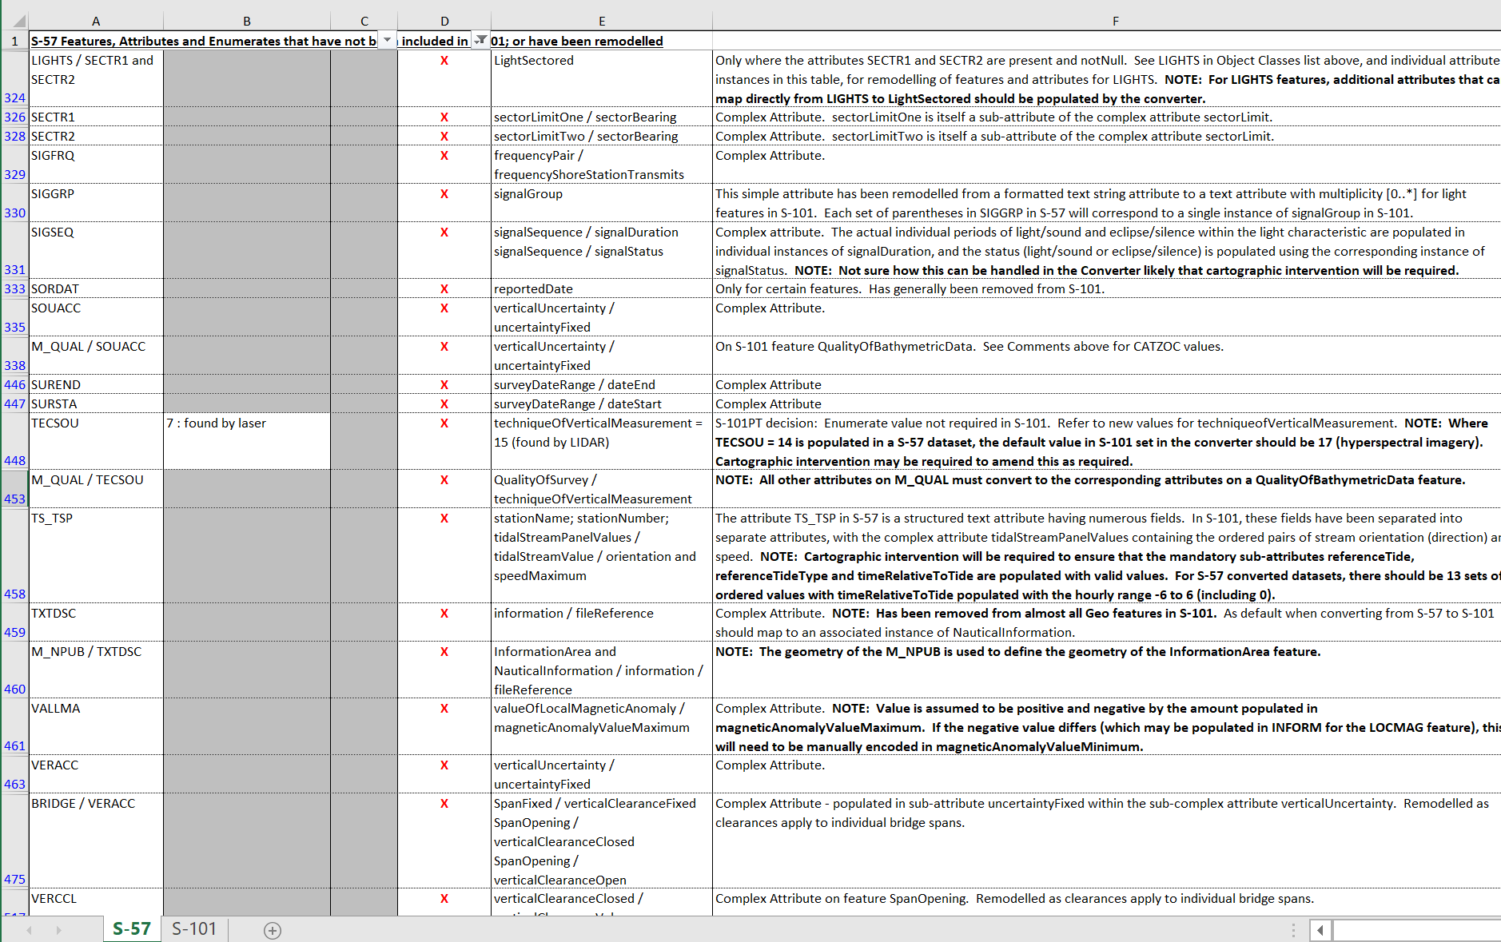
Re-modelling spreadsheet
Compiled alongside DCEG publication
Two separate tabs/sections
S-57 – Items (features, attributes or primitives) which are remodelled or dropped in conversion from S-57 to S-101
Dropped items can be identified (potentially in S-58)
Remodelled need to be
S-101 – Newly introduced items
Edge cases.
Documentation and comments also included
Our task is to create the “conversion” approach for each case identified

Slide 4
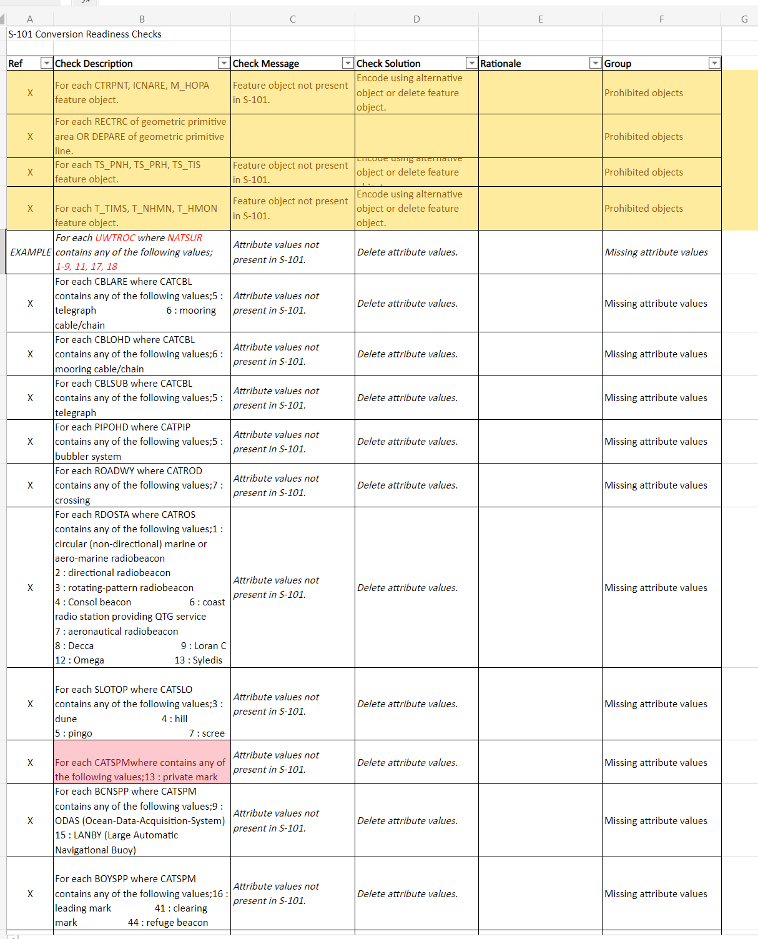
Conversion Readiness Checks
Remodelling spreadsheet identifies feature/attribute and geometry primitive bindings which are dropped in S-101
Proposal to define tests for these dropped bindings
Potentially include in future version of S-58 and use to evaluate readiness of data producer data for conversion to S-101
Draft test spreadsheet in GitHub

Slide 5
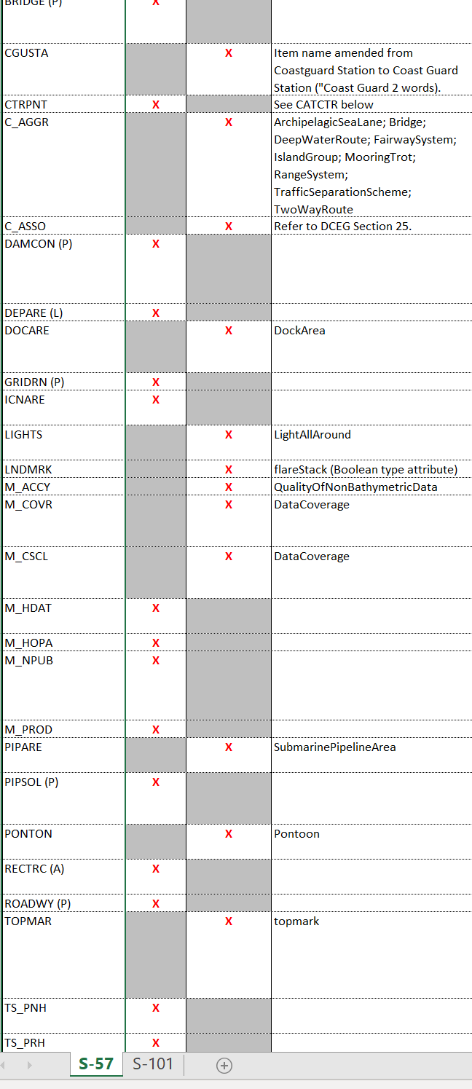
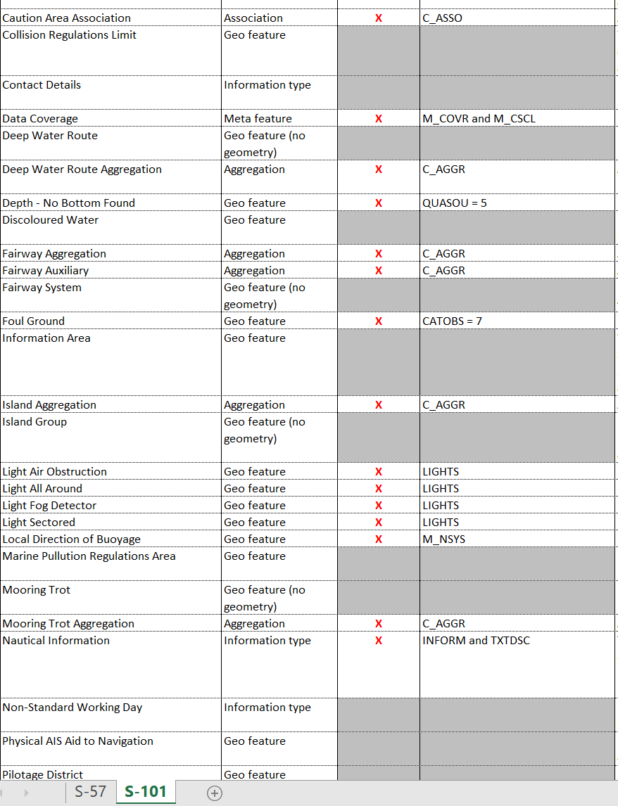
S-57
Conversion Process
Convert S-57 features which still have an equivalent representation in S-101
Drop those feature, attributes and attribute values which are not modelled in S-101
[S-57 tab] For each of the remodelled items, perform any automated or manual transformations necessary to populate the new S-101 cell
[S-101 tab] Where possible define transformations which populate new S-101 content .
S-101
S-57
Look at S-57 entries in spreadsheet (S-57 edge cases)
(only the “remodelled” items)
Determine how to “convert” from S-57 to S-101 equivalents and define how the conversion should be achieved, including attribute values and enumerations
Note:
Where manual input/cartographic judgement may be required
Where information is unlikely to be in the existing S-57 chart
Changes to attribution including enumeration values, mandatory attribution and any dropped information.
S-101
Look at S-101 entries in spreadsheet (items directly modelled in S-57)
Note:
Determine how they can be defined from S-57 and if data already exists in S-57/UOC
Where manual input may be required to fully define

Slide 6
How should we record these tasks? Alongside the spreadsheet items? New Tab?
Group similar cases together?
UOC grouping of features where possible for inclusion in the output document
 |  | Requires Data Preparation | Requires Cartographic Input | Requires Dataset Configuration | Conversion Procedure | Comment
DOCARE |  |  | X | DockArea | NOTE: DockArea is a Group 1 feature in S-101, therefore underlying Group 1 features must be amended to bound the DockArea feature to prevent overlapping coverage of Group 1 features when converting from S-57 to S-101.
 |  | Y | Maybe | Y - preference for substitution | Features which are NOT Group 1 features in S-57 but which ARE Group 1 in S-101 can be converted automatically if (1) An appropriate topologically correct Surface Geometry is available for use and (2) If the producer is prepared to accept the definition of a feature to act as the underlying Group 1 feature. For instance, if the producer is content to replace all DOCARE with an underlying UnsurveyedArea then the S-57 cell should be prepared with an UNSARE coincident with the DOCARE which can be replaced with DOCARE during the conversion process. | Needs diagrams in guidance document and fuller description of options along with pros and cons.
BCNSHP | 4 : lattice beacon |  | X | natureOfConstruction = 11 (latticed)
 |  | N | N | N | Transformation of BCNSHP=4 to natureOfConstruction=11 | check allowable values for features
RADWAL |  |  | X | radarWaveLength | Complex Attribute. NOTE: The constituent parts of RADWAL have been split in S-101 as the sub-attributes to the radarWaveLength complex. The radar band is encoded in the sub-attribute radarBand, and the wave length is encoded in the sub-attribute waveLengthValue. Cartographic intervention may be be required to ensure correct population of this complex attribute when converting from S-57.
 |  | Y | Maybe | N | RADWAL converts to complex attribute radarWavelength sub-attributes radarBand and waveLengthValue. Depends on how producer is currently encoding the two components of the RADWAL and existence of functionality of converter to correctly parse them. | Needs automated conversion process to correctly parse an existing value and populate radarWavelength complex attribute.

Slide 7
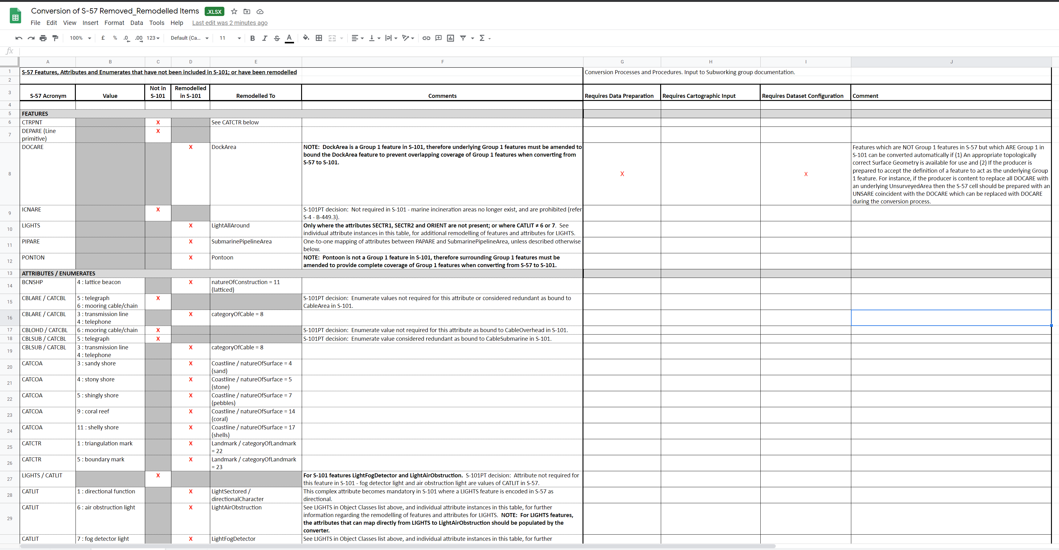

Slide 8
Way forward: Approach and Outputs
Proposal is to structure the output of the group according to the UOC/DCEG structure (next)
We can also group similar cases together where there is a similar approach and work on them together?
Some proposed groupings
Transformation of attributes into different simple/complex attributes (subdivide by UOC group)
Could be subdivided for particular attributes?
Can use feature catalogue as reference for e.g. mandated attributes.
Redefinition of attribute types (e.g. enumeration to Boolean)
Group 1 transformations
Features which are Group 1 in S-57 and not Skin of the Earth in S-101
Features which are not Group 1 in S-57 but are Skin of the Earth in S-101
Metadata features
M_QUAL/CATZOC
M_COVR / Scale
INFORM remodelling
Links to AdditionalInformation
TXTDSC and NTXDSC
M_NPUB approach
Lights
Try to deal with Lights as a whole to deal with all cases.
“Not in S-101” – deal with the Notes.
Features/Attribution new to S-101 – (the S-101 tab in the spreadsheet)

Slide 9
S-57 to S-101 conversion Sub Working Group (ENCWG)
Meeting 2 (VTC) – 2020-12-03
Proposal for the final « S-57 to S-101 Conversion » document

Slide 10
WHAT SHOULD the document be based on?
Various options:
S-57 Object Catalogue
S-101 Feature Catalogue
S-101 DCEG
S-57 UOC
New structure or format…
The conversion starting from S-57, and the document being mainly to the attention of encoders,
suggest to have a document based on the UOC:
Keep exactly the same chapter numbers
Useless chapters → keep the title and replace the text by: “Irrelevant.”
New Chapters: additional number (e.g. Caution Area)
Object 100% automatically converted: "S-57 to S-101 conversion is 1 to 1.“ (eg.)
For edge cases, guidance should be as complete and detailled as possible (various situations depending on the HO)
S-58 “Conversion checks” could be added in each relevant paragraph (with a complete table at the end?).
The final document should be much lighter than the UOC (138 pages → 25 pages???)

Slide 11
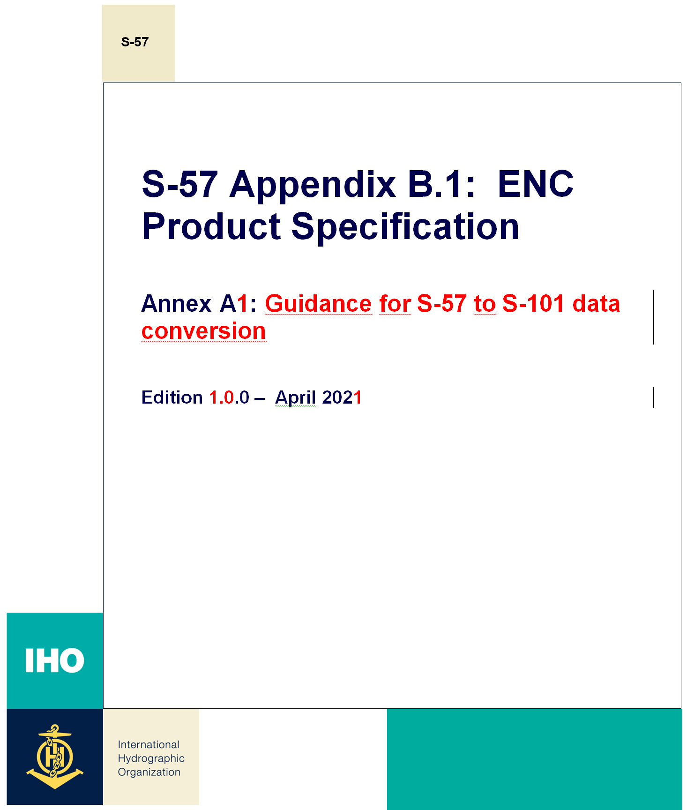
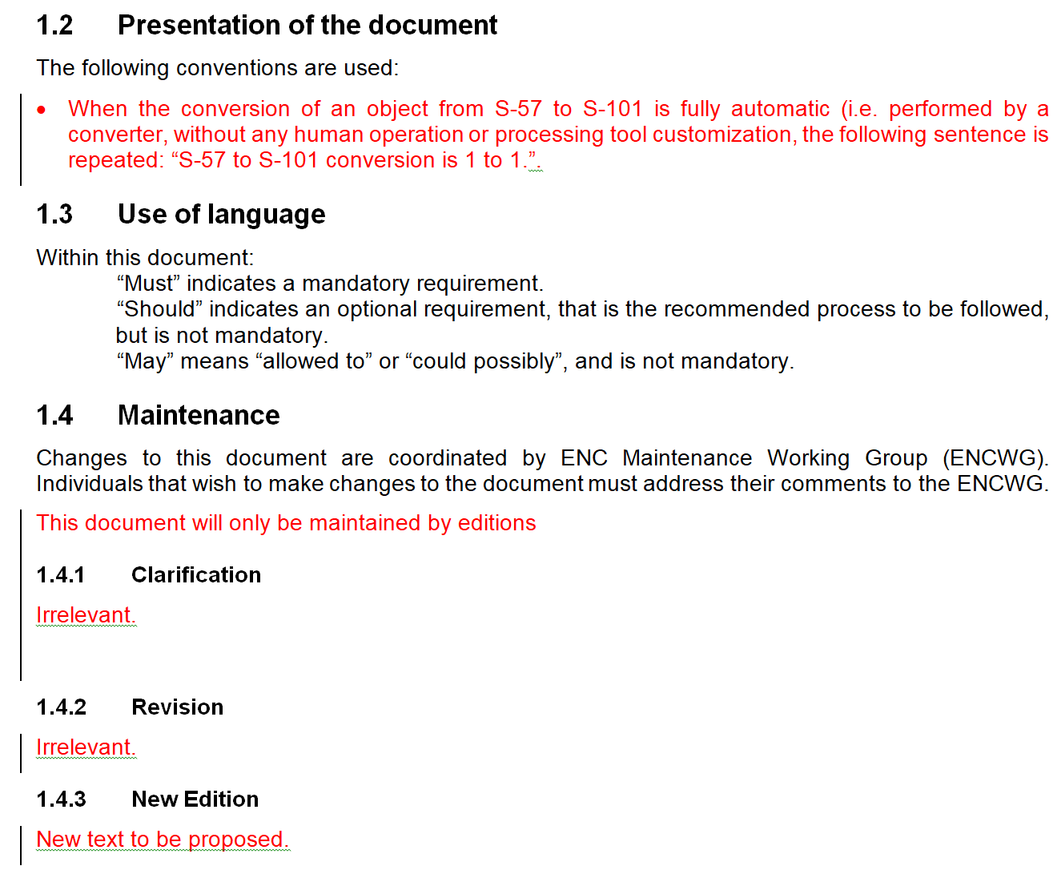
WHAT cOULD it look like (1/2)?

Slide 12
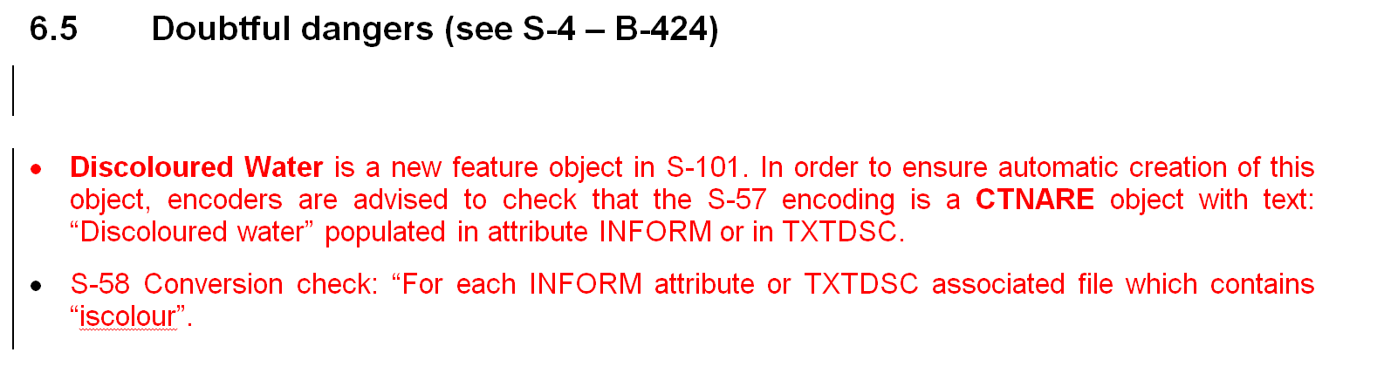
WHAT cOULD it look like (2/2)?

Slide 13
Where do we go?
We need to decide (before next meeting?) on the the final form.
Do we need agreement of HSSC (as it will be an IHO publication)?
Need to settle the use of language (next meeting?)

